Slide 1
GROUP MEMBERS:
1.YASH DESHPANDE(2123)
2.AMEY VAIKER(2128)
3.ROHAN KOTKAR(2131)
4.RANJEET BHOSALE(2132)

Slide 2
PROBLEM STATEMENT :
COVID CARE MANAGEMENT SYSTEM

Slide 3
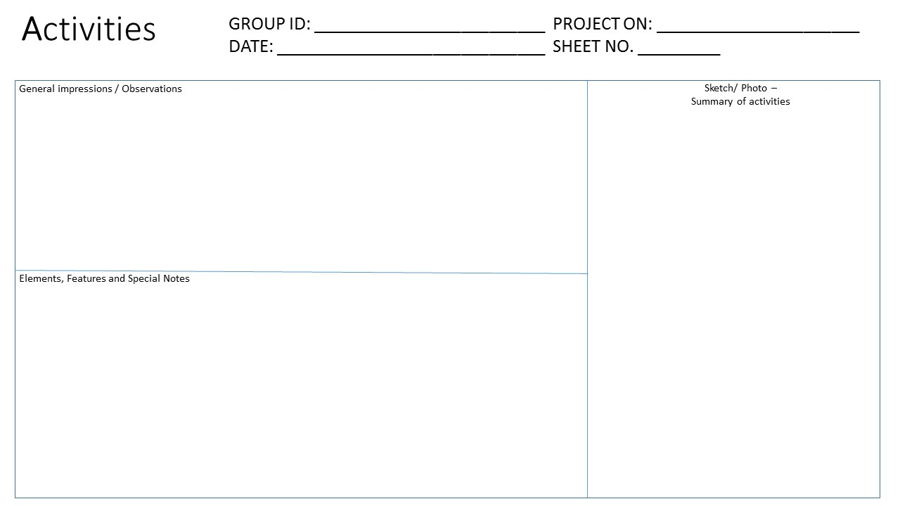
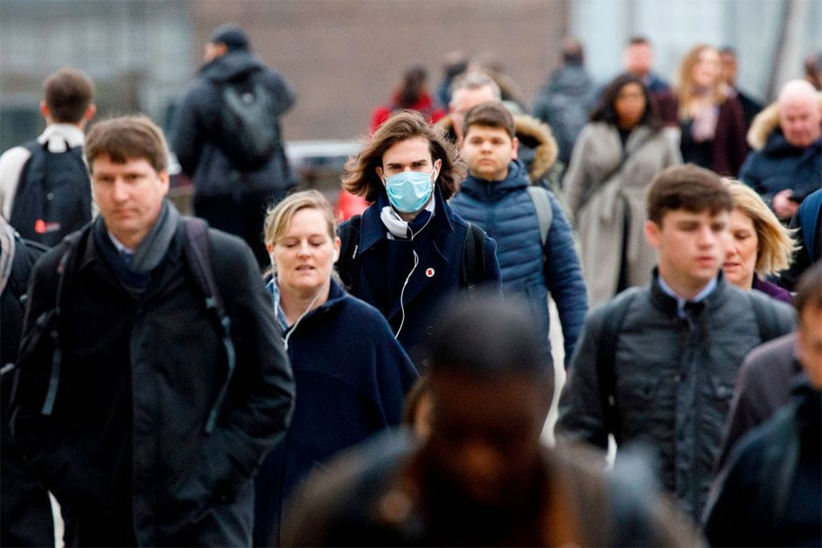
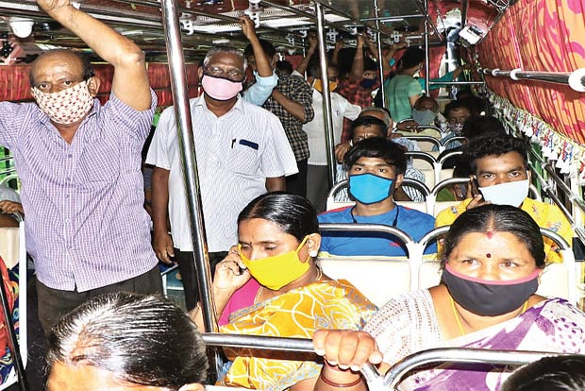
GROUP 1
COVID PROBLEMS
19 JAN 2021
1
1.Unaware of crowd places , so infection of various possibilities increases.
2.In case of Emergency , availability of Ambulance is the major objective for every patient to reach the hospital.
3.Registration for patient becomes tedious job in hospital.
4. People not following the basic guidelines circulated from government.
1.Crowded Area
2.People not using masks
3.People not maintaining social distance
4.Crowded public transports

Slide 4
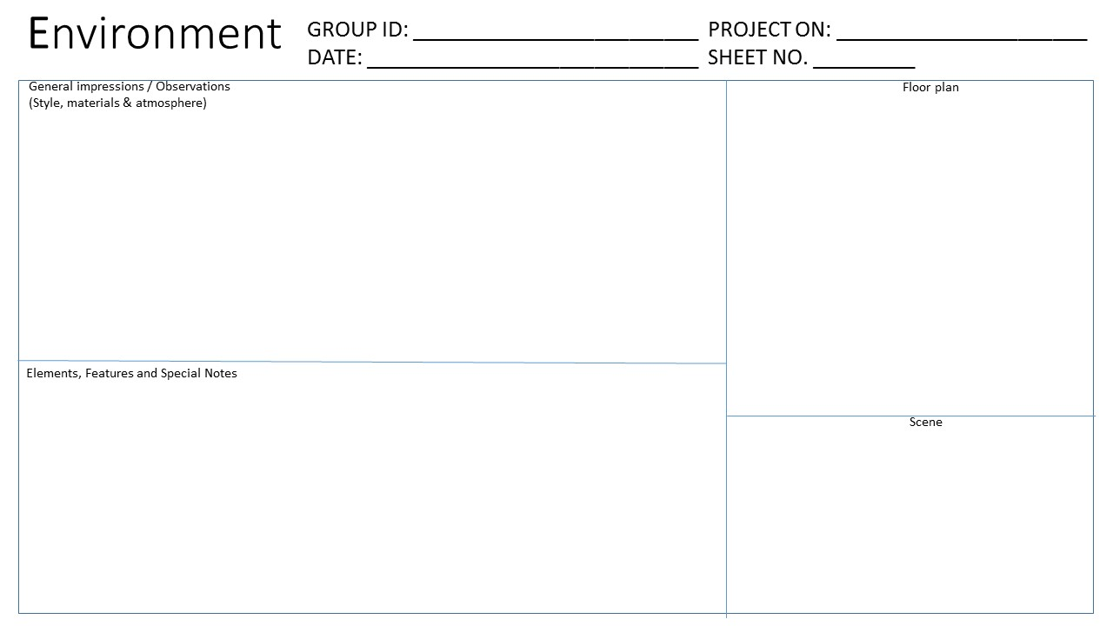
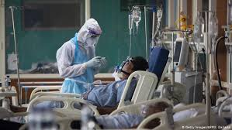
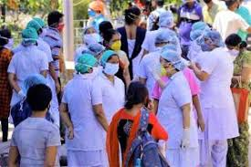
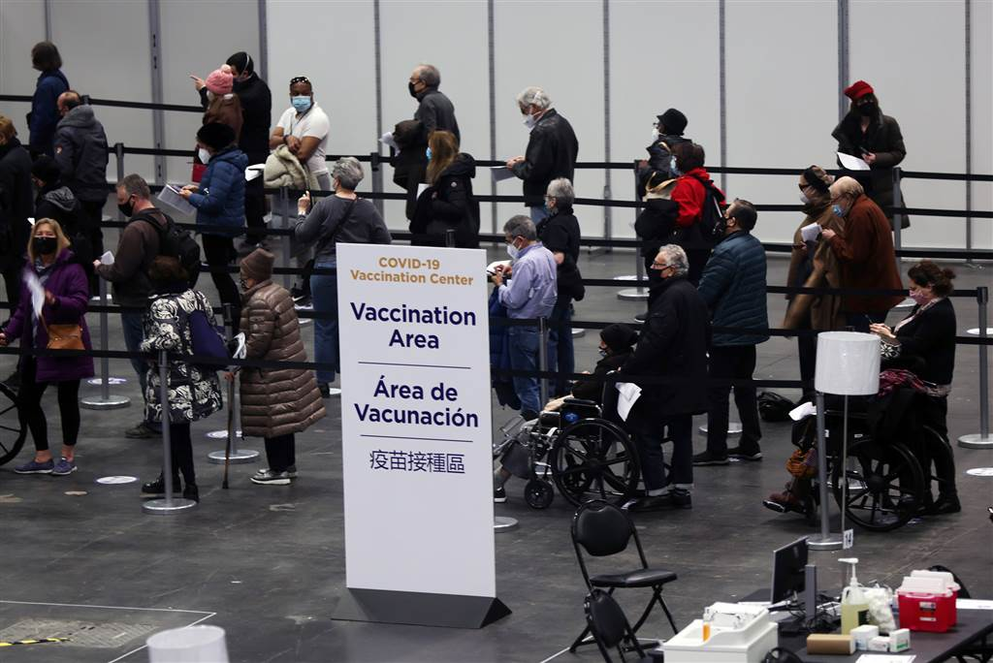
GROUP 1
COVID PROBLEMS
19 JAN 2021
2
1.Hospitals
2.Covid Testing Labs
3.Pathalogy
4.Crowded Areas
5.Vaccination Centres
1.General Safety
2.Infection Control
3.Bed Management in Hospitals
4.Availability of Ambulance at time of Emergency
5.Easy and proper vaccination

Slide 5
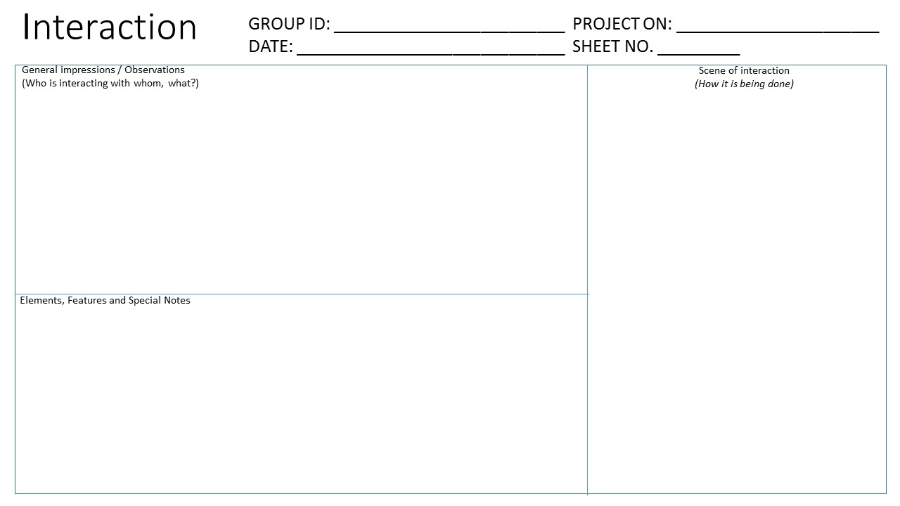
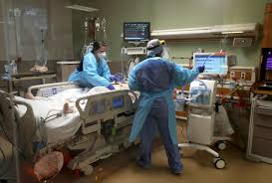
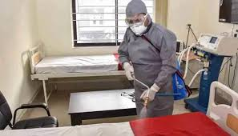
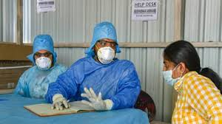
GROUP 1
COVID PROBLEMS
19 JAN 2021
3
1.Doctors
2.Health-Care Workers
3.Frontline Warriors
4. Crowded area people walking in
Affected people were facing problems for the following purpose:
Use of ambulance in emergency purpose
Vaccine registration
Management of hospital

Slide 6
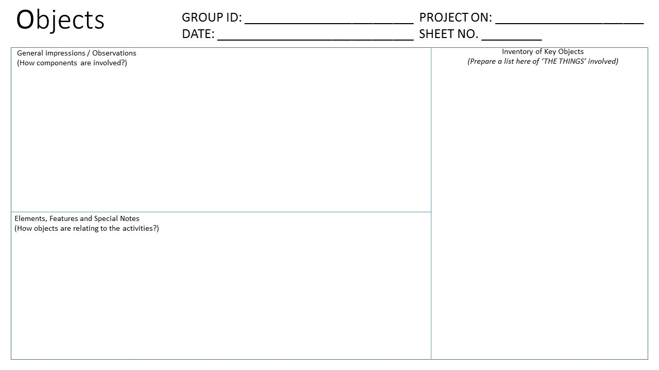
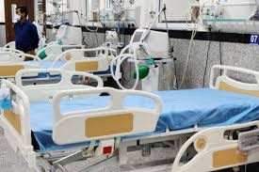
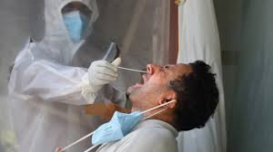
GROUP 1
COVID PROBLEMS
19 JAN 2021
4
1.Hospital
2. Vaccination Centers
3. Available Beds for covid
4.Vaccination Registration

Slide 7
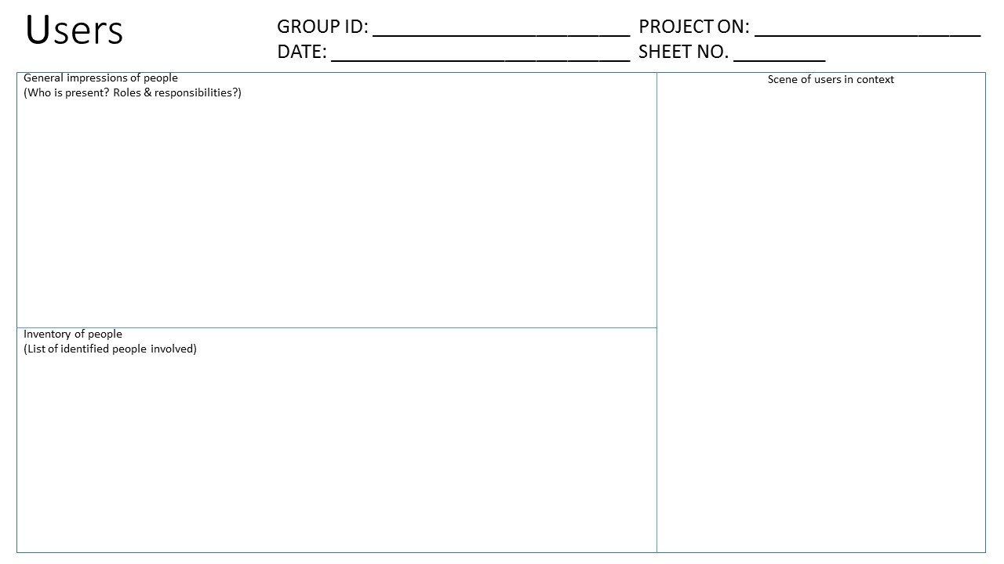
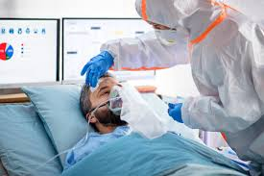
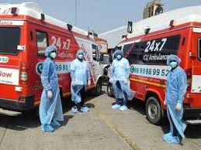
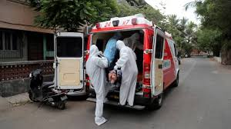
GROUP 1
COVID PROBLEMS
19 JAN 2021
5
1.Covid 19 patients
2.General people
3.Family of infected patient
4.Common people
1.Easy , Simple and Fast registration
2.24/7 registration of beds in covid hospital
3.Availability of Ambulance 24/7 .
4.If home quarantine then contact with Doctors anytime.

Slide 8
THANK YOU
ANY OUESTION ??

